Slide 1
Developing Periodic, Localized Molecular Orbitals
Mark Zanon
Nooijen Group

Slide 2
Outline
Motivation
Theory
Description of Algorithm
Results
Future Work
Questions

Slide 3
Motivation
Computational calculations can determine molecular properties:
Geometries
Electronic Structure
Thermochemistry*
Different levels of theory give different results
Hartree-Fock (HF)
Density functional theory (DFT)
Second order Møller–Plesset (MP2)
“Best” method: Coupled-Cluster Singles, Doubles, and Triples (CCSD(T))
~kcal/mol accuracy
Very computationally expensive (N⁷)

Slide 4
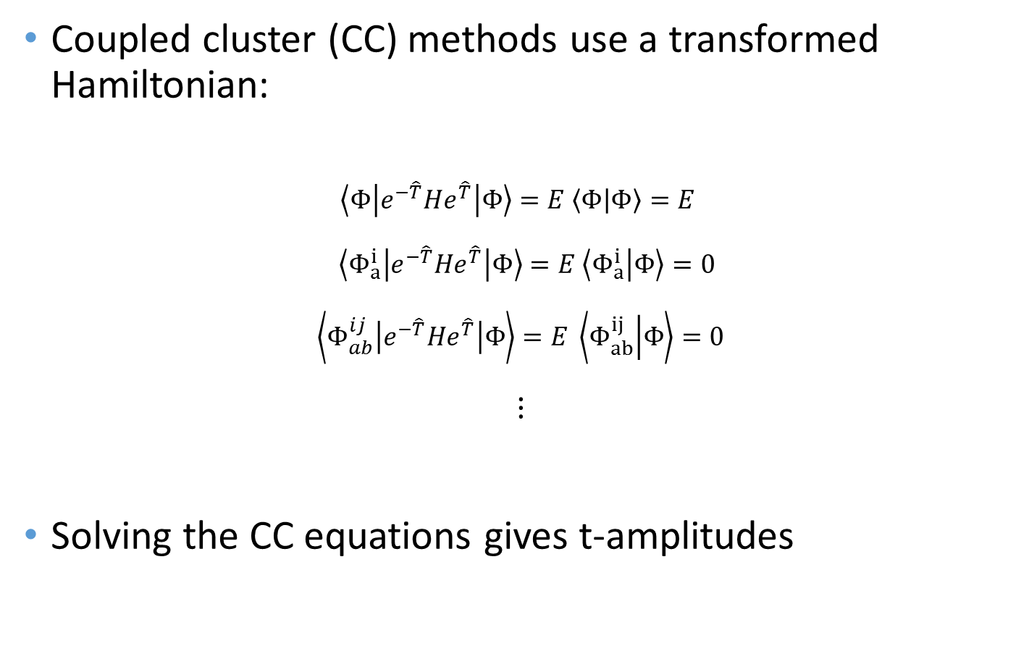
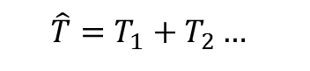
Motivation
Coupled cluster (CC) methods use a transformed Hamiltonian:
$$\left\langle Φ\left|e^{−\hat{T}}He^{\hat{T}}\right|Φ\right\rangle =E \left\langle Φ | Φ\right\rangle =E$$
$$\left\langle Φ_{a}^{i}\left|e^{−\hat{T}}He^{\hat{T}}\right|Φ\right\rangle =E \left\langle Φ_{a}^{i} | Φ\right\rangle =0$$
$$\left\langle Φ_{ab}^{ij}\left|e^{−\hat{T}}He^{\hat{T}}\right|Φ\right\rangle =E \left\langle Φ_{ab}^{ij} | Φ\right\rangle =0$$
$$\text{⋮}$$
Solving the CC equations gives t-amplitudes
$$\hat{T}=T_{1}+T_{2}…$$

Slide 5
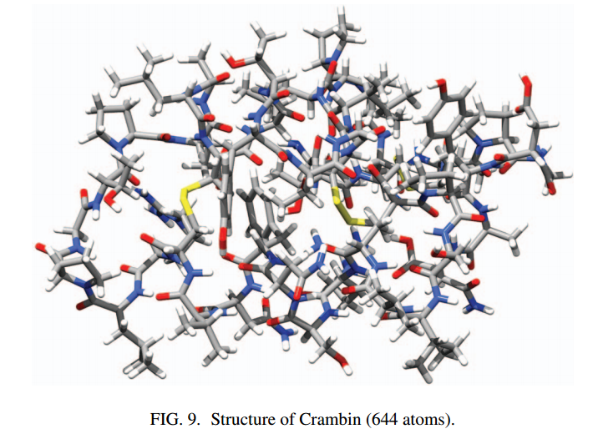
Recent Developments
CCSD(T) calculations with localized orbitals
Largest CCSD(T) calculation to date: Crambin
Completed using domain based local pair-natural orbital coupled-cluster (DLPNO-CC)
Crambin (644 atoms, 6100+ basis functions)
J. Chem. Phys. 139 134101 (2013)

Slide 6
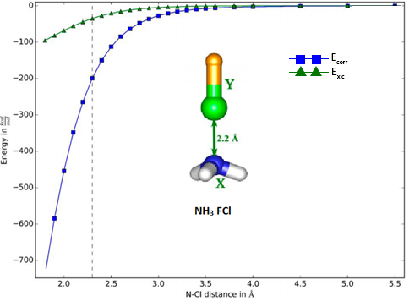
Recent Developments
Electron correlation falls with r⁻⁶
Localizing orbitals to ignore long range interactions greatly simplifies calculations:
J. Chem. Theory Comput. 2016, 12, 4778−4792
Notes:
A large part of the computational sailing in CC calculations is due to calculation of electron correlation. Full treatment of electron correlation increases the computational scaling by at least N⁴. But electron correlation has a sharp falloff of r to the negative six. This plot shows electron correlation energy (blue) and exchange energy (green) and you can clearly see that while there is heavy interaction between electrons on close atoms, once you hit approx. 3 angstroms the contributions to energy become almost negligible. By localizing orbitals, we can treat electron correlation locally (which is where it counts) and ignore long range interactions.

Slide 7
Orbital Localization
Recently developed DLPNO-CC gives reliable accuracy with a similar computation time as DFT
Classifies interactions with a hierarchy
Limitation: cannot use molecular symmetry (speedup) with localized orbitals
Can we combine orbital localization and molecular symmetry?
If one can do this, one can treat solids
Notes:
This DLPNO-CC method has been show to scale similarly to DFT, while providing more accurate results. This treatment sorts electron correlation pairs into a hierarchy. Interactions between electrons which are far apart are ignored. Interactions between atoms that are a medium distance away are estimated with MP2. Interactions between very close pairs of atoms are given full CC treatment.
Unfortunately there is a but of a limitation. In calculations with canonical orbitals, we gain a speedup due to molecular symmetry. We do not gain this speedup with localized orbitals. Can we combine orbital localization and Mol. Sym? If we can, we can start talking about doing CC calculation on solids.

Slide 8
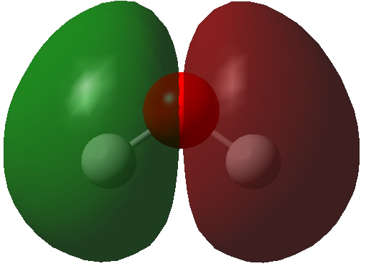
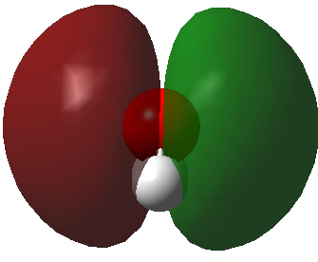
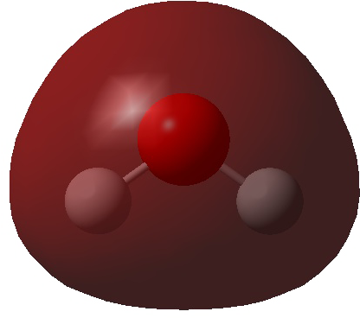
Simplifying Calculations with Molecular Symmetry
Canonical orbitals transform according to their irreducible representations:
Canonical orbitals can be used with canonical CCSD(T)
System size limited due of scaling
Many t-amplitudes are zero by symmetry and do not need to be calculated. But: no sparsity due to localization
Goal: find orbitals which are localized and exhibit molecular symmetry
Notes:
Canonical orbitals transform according to their irreducible representations. The symmetry in the orbitals reflect the symmetry of the molecule. We can see that the planes of symmetry in water correspond to nodal planes in the orbitals. We use these orbitals with CCSD(T). Because of this symmetry, the Hamiltonian takes on a block form and may t-amplitudes become zero. This may reduce calculation time by a factor of 2 or 10 or 50, but this speedup is negligable when your method scales sharply. We now have a clear goal: Find a set of orbitals which are localized and exhibit molecular symmetry.

Slide 9
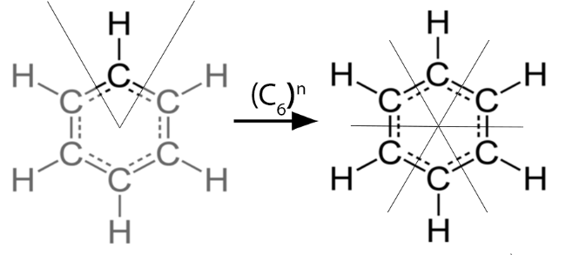
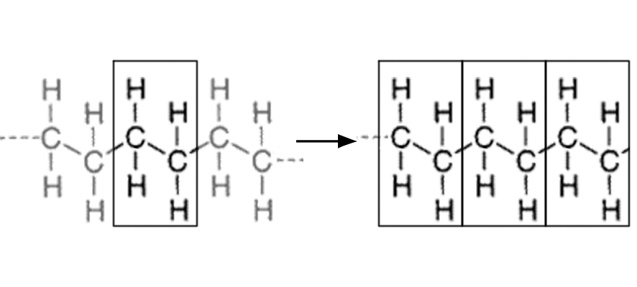
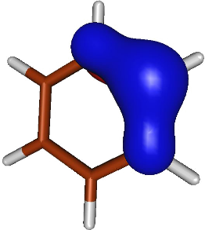
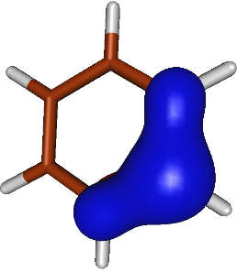
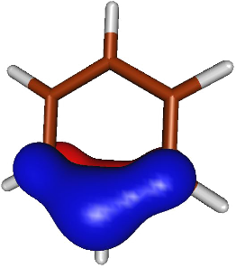
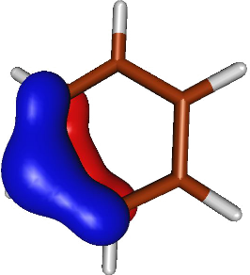
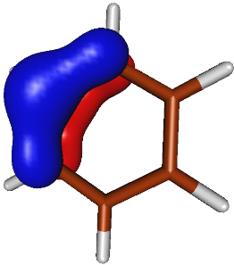
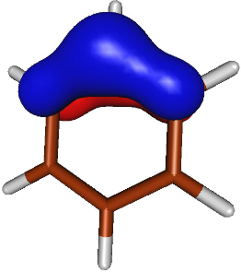

Molecular Symmetry
Molecules can be broken up into repeating unit cells which transform via irreducible representations
Results: Localized benzene $π$orbitals that exhibit this C₆ symmetry
Interestingly, we get 6 $π$ orbitals instead of the expected 3
…
Notes:
I present another intuitive way to think symmetry. Using molecular symmetery, systems can be broken up into unit cells relatable through some geometerical transformation L. In the case of bezene, the molecule is broken up into 6 CH unit cells and L is a rotation about the C6 axis. The other example here is Polyethelene, which can be though of as a C2H4 unit cell with L being is a translation in the plane of the moelcule. Here is a sneak peak at our results, we see that when we localize orbitals onto the unit cell we choose, our localized orbitals exhibit the symmetry present in the molecule. Interestingly, we get six pi orbitals instead of the expected three. This is kind of expected as we have six unit cells.

Slide 10
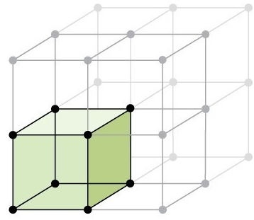
Combining Symmetry and Localization
Only one T-amplitude needs to be calculated for each set of equivalent orbitals
Calculations are greatly simplified
By combining symmetry and localization, we can preform CC calculations on larger systems
My contribution: Investigate the construction of these orbitals
Notes:
The orbitals between two unit cells are identical, meaning only a single t-amplidude needs to be calculated for each set of equivalent orbitals. The net result is that calculations are greatly simplified. By combining orbital localization and molecular symmetry, we can start talking about preforming CC calculations on very large systems, such as solids. Once the properties of the unit cell are calculated, we can extend the unit cell in any direction we please.

Slide 11
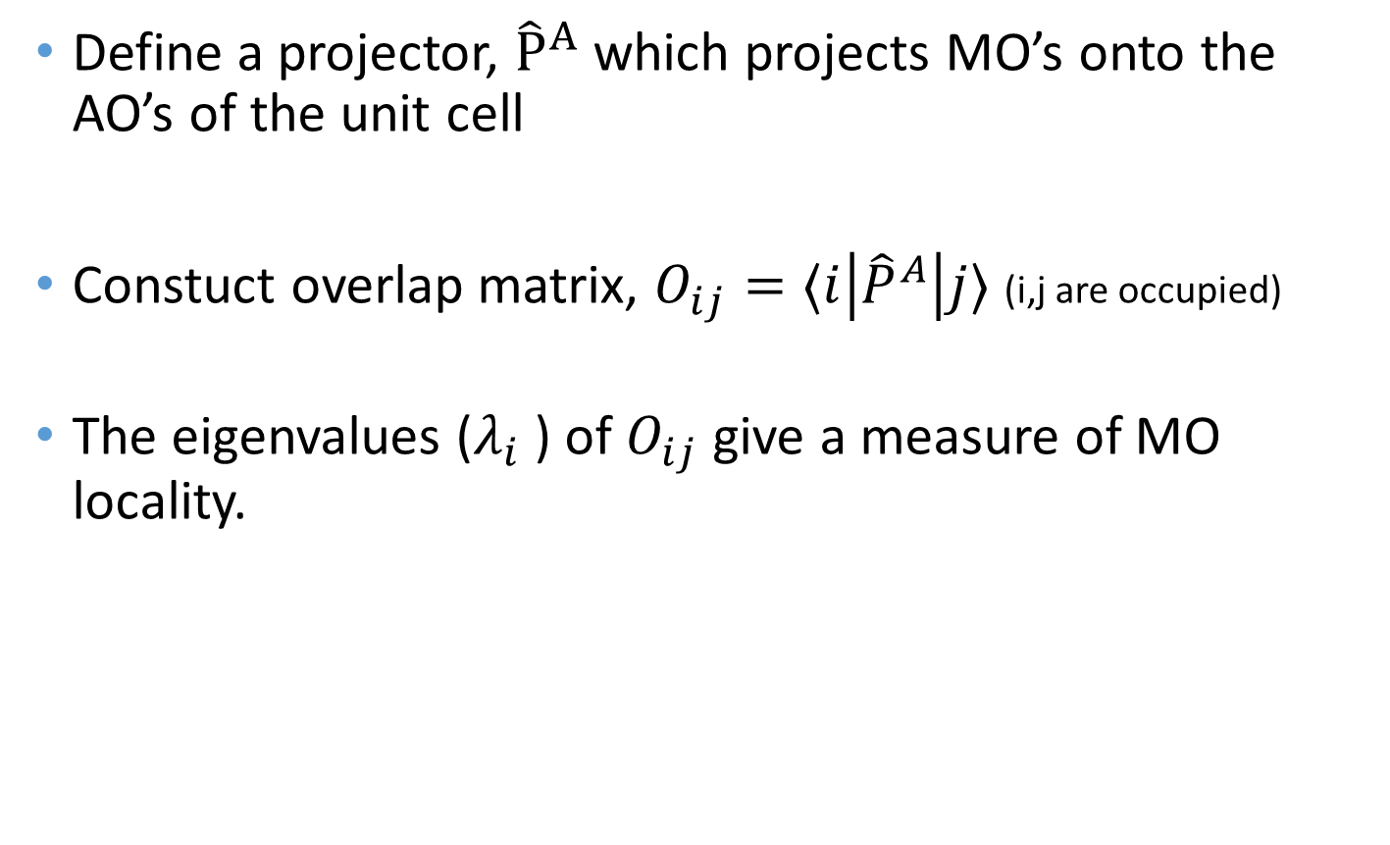
Description of Algorithm
Define a projector, ${\hat{P}}^{A}$ which projects MO’s onto the AO’s of the unit cell
Constuct overlap matrix, $O_{ij}=⟨i\left|{\hat{P}}^{A}\right|j⟩$ (i,j are occupied)
The eigenvalues ($λ_{i}$) of $O_{ij}$ give a measure of MO locality.

Slide 12
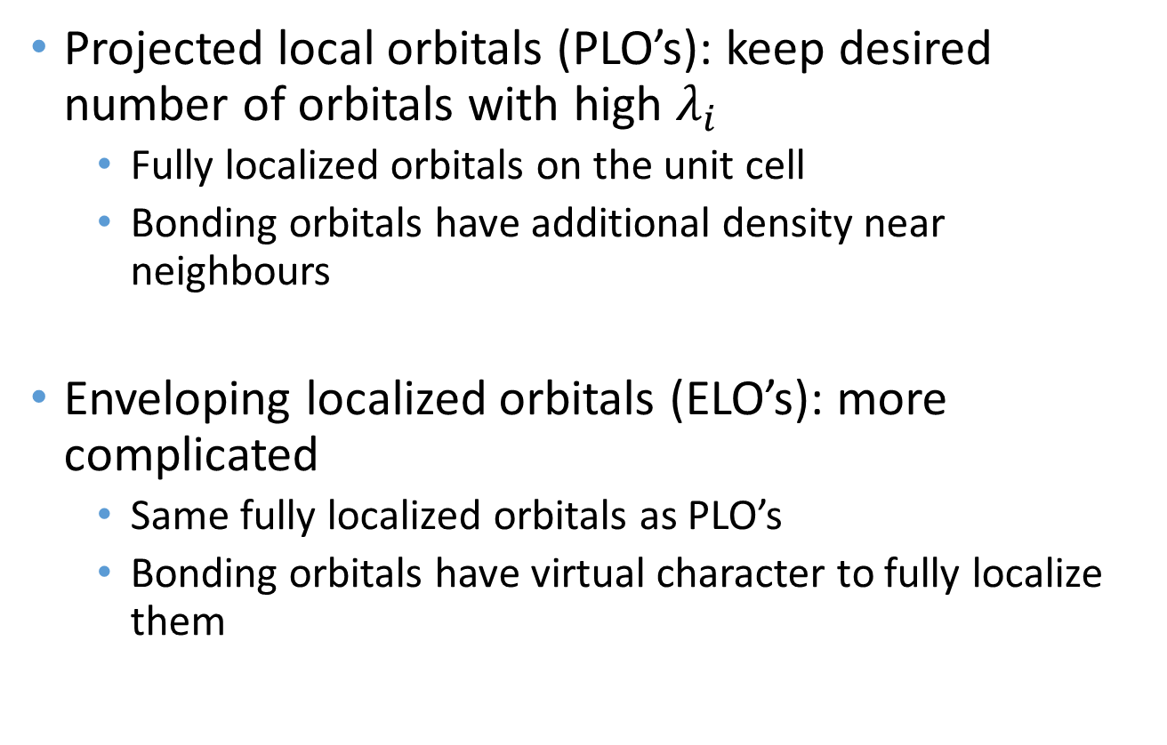
Description of Algorithm
Projected local orbitals (PLO’s): keep desired number of orbitals with high $λ_{i}$
Fully localized orbitals on the unit cell
Bonding orbitals have additional density near neighbours
Enveloping localized orbitals (ELO’s): more complicated
Same fully localized orbitals as PLO’s
Bonding orbitals have virtual character to fully localize them

Slide 13
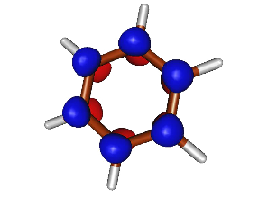
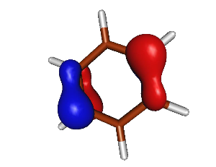
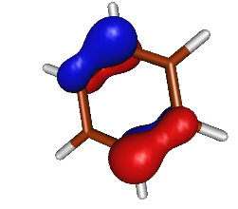
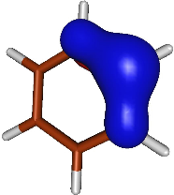
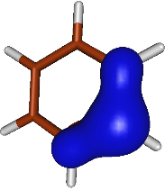
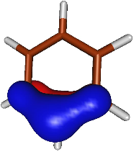
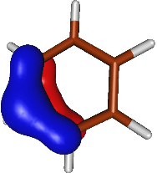
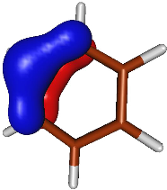

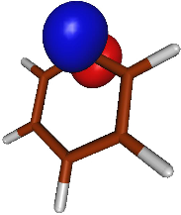
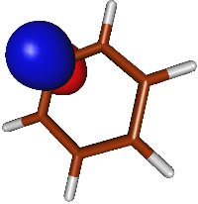
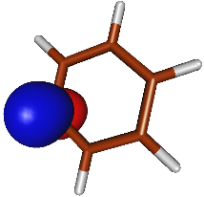
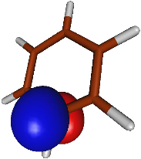
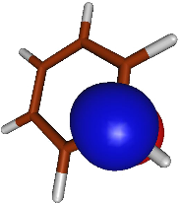
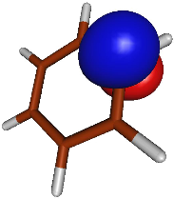
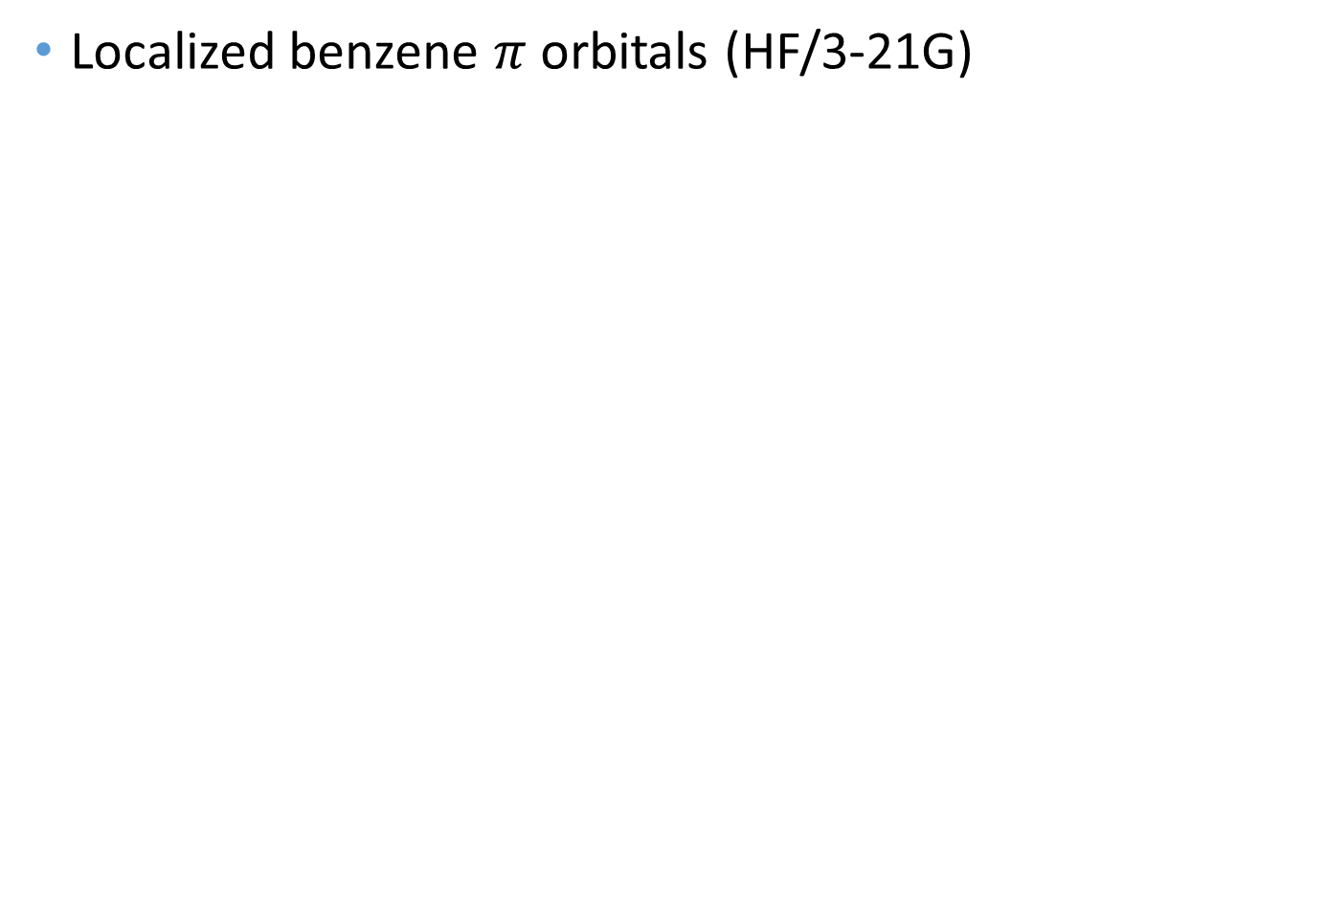
Results
Localized benzene $π$ orbitals (HF/3-21G)
Cannonical
PLO’s
ELO’s
Notes:
These are our first results, orbitals were formed using HF/3-21G, calculated in ACESII using Dr Nooijen’s algorithm and plotted in MOLDEN. Here is a direct comparison between the three canonical benzene pi orbitals, and the set of six PLO’s and six ELO’s which are equivalent. Needless to say, there is something strange with these orbitals.

Slide 14
Projected Localized Orbitals (PLO’s)
PLO’s are non-orthogonal
Relatively intuitive
Notes:
Lets take a closer look at the PLO’s. As you can see these PLO’s are non-orthogonal. That is to say, you can create a linear combination of these orbitals with zero electron density everywhere. This may sound a little hand wavy but you can see that the orbitals do have some overlap. These orbitals are relatively intuitive in that they have a lot of density on the unit cell that we chose and there is also some density leaking out towards neighbouring atoms. If I had asked you to take some time and think of what dividing the benzene orbitals looked like you would likely come up with something along these lines.

Slide 15
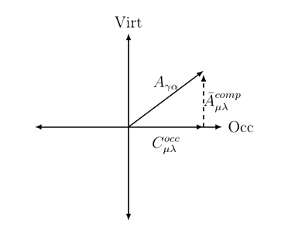
Enveloping Localized Orbitals
We can choose virtual orbitals to precisely compensate for the orbital components lost.
Orbitals are fully localized
Notes:
READ SLDIE. U DO U. Using these six ELO’s, you can take a linear combination and re-create any of the six benzene pi bonding/antibonding orbitals.

Slide 16
Cannonical orbitals, PLO’s, ELO’s
 | Cannonical MO’s | PLO’s | ELO’s
Localized | No | Yes | Yes
Orthogonal | Yes | No | Choose
Occupied orbitals have pure occupied character (Occupied and virtual orbitals do not mix) | Yes | Yes | No

Slide 17
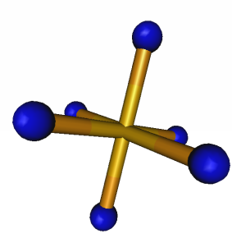
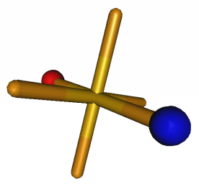
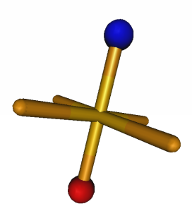
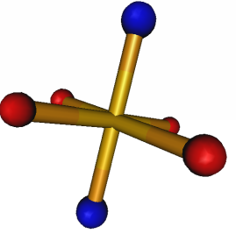
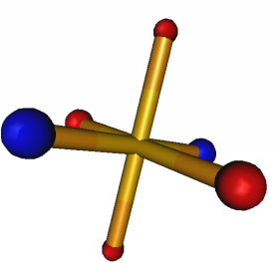
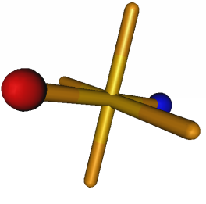
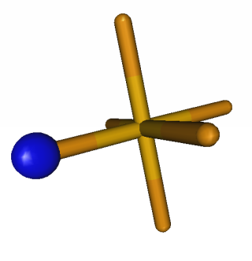
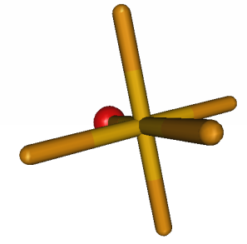
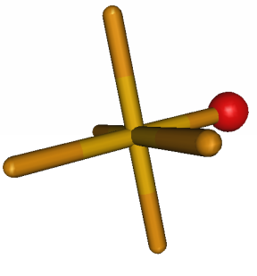
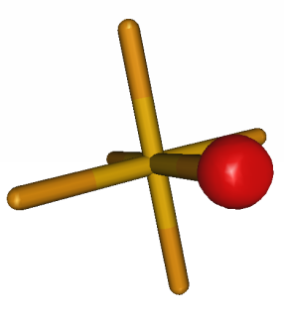
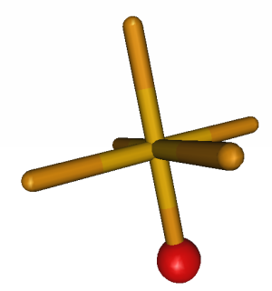
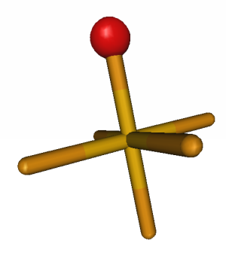
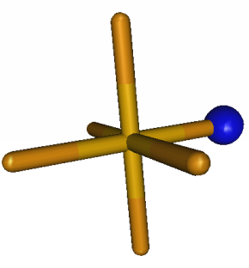
SF₆
Canonical
PLO’s
ELO’s
Notes:
As I said before, we expect some ELO’s and PLO’s to look the same, and some to look different. These canonical orbitals are the ligand group orbitals corresponding to combinations of the fluorine 1s orbital. The ElO’s and PLO’s look identical. They represent the individual fluorine 1s orbitals.

Slide 18
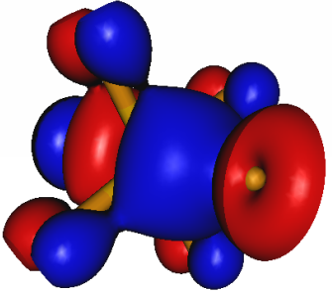
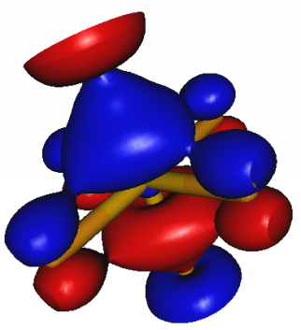













SF₆
Canonical
PLO’s
ELO’s
Notes:
These are the ELO’s and PLO”s that look different. The canonical orbitals correspond to the fluorine p LGO’s bonding to the sulfur p orbitals. As you can see the ELO’s are much more localized than their PLO counterparts. But PLO’s give more insight into the bonding within the system.

Slide 19













Cubane
PLO’s
ELO’s
Notes:
Our next example is cubane, which is exactly what it sounds like. IN in particular, we are looking at the CH bonding within cubane. In interest of space I am not showing all of the PLO’s and ELO’s, but rest assured the PLO’s and ELO’s 8 orbitals corresponding to the 8 unit cells. In this case, you can see that the orbitals take the form of carbon SP3 hybrid orbitals and are completely localized. This is because the CH boding is completely contained within the unit cell.

Slide 20












Cubane
PLO’s
ELO’s
Notes:
These are some of the Carbon carbon bonding orbitals of cubane. Because these orbitals correspond to orbitals cutting across unit cells, the PLO’s and ELO’s look fairly different. Again the PLO’s tend to give insight into the bonding between unit cells while the ELO’s are much more localized. This is because of that virtual character mixed into the ELO’s.

Slide 21




PLO’s with no equivalent ELO’s

Slide 22






Effect of Basis Set on Orbitals
Additional calculations for small systems done at HF/cc-PVTDZ
Occupied orbitals remain mostly unchanged
ELO virtuals are large, diffuse, and periodic

Slide 23









Choice of Unit Cell
We can choose different unit cells to obtain different sets of orbitals
Benzene PLO’s: CH vs C₂H₂
Notes:
Our algorithm is fairly flexible. We are free to chose the unit cells however we please. Here is a comparison between the PLO’s obtained when we use CH as the unit cell vs when we use C2H2 as the unit cell.

Slide 24


Python script written by Mike Lecours to help pick out equivalent atoms within a cluster
Clear potential for speedup
96 atoms - 8 unique

Slide 25
Conclusions
We have developed a method for constructing localized orbitals which reflect the symmetry of the system.
PLO’s are localized, non-orthogonal orbitals which can give insight into the bonding between unit cells
ELO’s are extremely localized, orthogonal orbitals with virtual character
Local CC methods done with PLO’s or ELO’s should offer a significant reduction in computational complexity without sacrificing much accuracy.

Slide 26
Future Work
Larger basis sets
Further testing of the algorithm
Automatic determination of unit cell and symmetry operations
Development of a full CC code using PLO’s, ELO’s is underway in collaboration with Dr. Ondrej Demel

Slide 27



Acknowledgements
Dr. Marcel Nooijen
Mike Lecours
Theoretical Chemistry Department
Johnny and Max

